Slide 2
DK Google Slides template
January 2020

Slide 3

You can copy and paste the footer from this page

Slide 4
Using the new slide template

Slide 5


Full bleed opener
Smaller heading size - 1 line only

Slide 6
Full bleed opener
over two lines
Smaller heading size - 1 line only

Slide 7
Red full bleed opener
Smaller heading size - 1 line only

Slide 8
Red full bleed opener
over two lines
Smaller heading size - 1 line only

Slide 9
White opener option
Smaller heading size - 1 line only

Slide 10
White opener option
over two lines
Smaller heading size - 1 line only

Slide 11

Sits on 1st pink line
Sits on third pink line aptent taciti sociosqu ad litora torquent per conubia nostra, per inceptos himenaeos. Mauris sit amet orci odio, ut rutrum mi. Aenean ligula diam, venenatis nec dictum ut, varius sit amet ligula.
Sed blandit, enim tincidunt luctus consequat, arcu ligula elementum eros, gravida fermentum risus urna ac risus.
March, 2021
Flexi/PB | 256pp | 233 x 195
£16.99 UK | $19.99 US

Slide 12
Two line heading
with some intro
If heading has 2 lines then text sits here aptent taciti sociosqu ad litora torquent per conubia nostra, per inceptos himenaeos. Mauris sitamet orci odio, ut rutrum mi. Aenean ligula diam, venenatis nec dictum ut, varius sit amet ligula.
Sed blandit, enim tincidunt luctus consequat, arcu ligula elementum eros, gravida fermentum risus urna ac risus.
March, 2021
Flexi/PB | 256pp | 233 x 195
£16.99 UK | $19.99 US

Slide 13


Slide 14
A-Heading - three fields
X-head on 3rd pink line
Class aptent taciti sociosqu ad litora torquent per conubia nostra, per inceptos himenaeos. Mauris sit amet orci odio, ut rutrum mi. Aenean ligula diam, venenatis nec dictum ut, varius sit amet ligula.
Sed blandit, enim tincidunt luctus consequat, arcu ligula elementum eros, gravida fermentum risus urna ac arcu ligula elementum eros,risus. Sed blandit, enim tincidunt luctus consequat, arcu ligula elementum eros, gravida fermentum risus urna ac risus. Morbi molestie faucibus purus, et bibendum libero sollicitudin.ed blandit, enim tincidunt.
X-head
Class aptent taciti sociosqu ad litora torquent per conubia nostra, per inceptos himenaeos. Mauris sit amet orci odio, ut rutrum mi. Aenean ligula diam, venenatis nec dictum ut, varius sit amet ligula.
Sed blandit, enim tincidunt luctus consequat, arcu ligula elementum eros, gravida fermentum risus urna ac arcu ligula elementum eros,risus. Sed blandit, enim tincidunt luctus consequat, arcu ligula elementum eros, gravida fermentum risus urna ac risus. Morbi molestie faucibus purus, et bibendum libero sollicitudin. avida fermentum risus.
X-head
Class aptent taciti sociosqu ad litora torquent per conubia nostra, per inceptos himenaeos. Mauris sit amet orci odio, ut rutrum mi. Aenean ligula diam, venenatis nec dictum ut, varius sit amet ligula.
Sed blandit, enim tincidunt luctus consequat, arcu ligula elementum eros, gravida fermentum risus urna ac arcu ligula elementum eros,risus. Sed blandit, enim tincidunt luctus consequat, arcu ligula elementum eros, gravida fermentum risus urna ac risus. Morbi molestie faucibus purus, et bibendum libero sollicitudin. ac arcu ligula elementum.

Slide 15
Heading sits on 1st pink line
X-head on 3rd pink line
Note: Body copy has Paragraph spacing (After) of 15 in order to keep the larger x-head on the grid. The body copy has no Paragraph after spacing.Sed blandit, enim tincidunt luctus consequat, arcu ligula elementum eros, gravida fermentum risus urna ac risus.
X-head
Mauris sit amet orci odio, ut rutrum mi. Sed blandit, ad litora torquent per conubia nostraenim tincidunt luctus consequat. Class aptent taciti sociosqu ad litora. Sed blandit, enim tincidunt luctus consequat, arcu ligula t amet orci odio, ut rutrum mi
Class aptent taciti sociosqu ad litora torquent per conubia nostra, per inceptos himenaeos. Mauris sit amet orci odio, ut rutrum mi. Aenean ligula diam, venena . Sed blandit, enim tincidunt luctus consequat, arcu ligula elementum eros, gravida fermentum risus urna ac risus. Mauris sit amet orci odio, ut rutrum mi. Sed blandit, enim tincidunt luctus consequat.
X-head
Class aptent taciti sociosqu ad litora torquent per conubia nostra, per inceptos himenaeos set amit. Class aptent taciti sociosqu ad litora ad litora uctus consequat, arcu ligula elemen.
Class aptent taciti sociosqu ad litora torquent per conubia nostructus consequat, arcu ligula elemensit amet orci odio, ut rutrum mi. Aenean ligula diam, venena . Sed blandit, enim tincidunt luctus consequat, arcu ligula elementum eros, gravida fermentum risus urna ac risus. Mauris sit amet orci odio, ut rutrum mi. Sed blandit, enim tincidunt luctus consequat. Class aptent taciti sociosqu ad litora torquent per conubia nostra, per inceptos .Class aptent taciti sociosqu ad litora torquent per conubia nostra, per inceptos himenaeos set amit. Class aptent taciti sociosqu ad uctus cons equat, arcu ligula elemen.
Baseline grid is
+0.64

Slide 16
Inserted images with captions
X-head on 3rd pink line
Note: Body copy has Paragraph spacing (After) of 15 in order to keep the larger x-head on the grid. The body copy has no Paragraph after spacing.Sed blandit, enim tincidunt luctus consequat, arcu ligula elementum eros, gravida fermentum risus urna ac risus. Mauris sit amet orci odio, ut rutrum mi. Sed blandit, ad litora torquent per conubia nostraenim tincidunt luctus consequat. Class aptent taciti sociosqu ad litora. Sed blandit, enim tincidunt luctus consequat, arcu ligula t amet orci odio, ut rutrum mi.Class aptent taciti sociosqu ad litora. Sed blandit, enim tincidunt luctus.
Class aptent taciti sociosqu ad litora torquent per conubia nostra, per inceptos himenaeos. Mauris sit amet orci odio, ut rutrum mi. Aenean ligula diam, venena . Sed blandit, enim tincidunt luctus consequat, arcu ligula elementum eros, gravida fermentum risus urna ac risus. Mauris sit amet orci odio, ut rutrum mi. Sed blandit, enim tincidunt luctus consequat. Class aptent taciti sociosqu ad litora torquent per conubia nostra, per inceptos .Class aptent taciti sociosqu ad litora torquent per conubia nostra, per inceptos himenaeos set amit. uctus consequat, arcu ligula. entum eros, gravida fermentum.
Baseline grid is
+0.64
Caption
Last line of caption text aligns at the bottom to an adjacent text line. Space between image and caption head baseline is equivalent to one line-feed on main body text.

Slide 17
A-Heading - three fields
X-head on 3rd pink line
Note: Body copy has Paragraph spacing (After) of 15 in order to keep the larger x-head on the grid. The body copy has no Paragraph after spacing.Sed blandit, enim tincidunt luctus consequat, arcu ligula elementum eros, gravida fermentum risus urna ac risus.
Mauris sit amet orci odio, ut rutrum mi. Sed blandit, ad litora torquent per conubia nostraenim tincidunt luctus consequat. Class aptent taciti sociosqu ad litora. Sed blandit, enim tincidunt luctus consequat, arcu ligula t amet orci odio, ut rutrum mi.Class aptent taciti sociosqu ad litora.
X-head
Class aptent taciti sociosqu ad litora torquent per conubia nostra, per inceptos himenaeos. Mauris sit amet orci odio, ut rutrum mi. Aenean ligula diam, venenatis nec dictum ut, varius sit amet ligula.
Sed blandit, enim tincidunt luctus consequat, arcu ligula elementum eros, gravida fermentum risus urna ac arcu ligula elementum eros,risus. Sed blandit, enim tincidunt luctus consequat, arcu ligula elementum eros, gravida fermentum risus urna ac risus. Morbi molestie faucibus purus, et bibendum libero sollicitudin. avida fermentum risus.
X-head
Class aptent taciti sociosqu ad litora torquent per conubia nostra, per inceptos himenaeos. Mauris sit amet orci odio, ut rutrum mi. Aenean ligula diam, venenatis nec dictum ut, varius sit amet ligula.
Sed blandit, enim tincidunt luctus consequat, arcu ligula elementum eros, gravida fermentum risus urna ac arcu ligula elementum eros,risus. Sed blandit, enim tincidunt luctus consequat, arcu ligula elementum eros, gravida fermentum risus urna ac risus. Morbi molestie faucibus purus, et bibendum libero sollicitudin. ac arcu ligula elementum.

Slide 18
A-Heading - two fields with intro
This intro text sits on the 2nd pink line sociosqu ad litora torquent per conubia nostra, per inceptos nec himenaeos. Aenean ligula diam, venenatis nec dictum ut.
With into text sits on 4th pink line lass aptent taciti sociosqu ad litora torquent per conubia nostra, per inceptos himenaeos. Mauris sit amet orci odio, ut rutrum mi. Aenean ligula diam, venena . Sed blandit, enim tincidunt luctus consequat, arcu ligula elementum eros, gravida fermentum risus urna ac risus. Mauris sit amet orci odio, ut rutrum mi. Sed blandit, enim tincidunt luctus consequat. Class aptent taciti sociosqu ad litora torquent per conubia nostra, per inceptos .
Class aptent taciti sociosqu ad litora torquent per conubia nostra, per inceptos himenaeos set amit. Class aptent taciti sociosqu auat, arcu ligula elementum eros, gravida fermentum risus urna ac arcu ligula elementum eros,risus. Sed blandit, enim tincidunt luctusd litora torquent per.
Class aptent taciti sociosqu ad litora torquent per conubia nostra, per inceptos himenaeos. Mauris sit amet orci odio, ut rutrum mi. Aenean ligula diam, venenatis nec dictum ut, varius sit amet ligula.
Sed blandit, enim tincidunt luctus consequat, arcu ligula elementum eros, gravida fermentum risus urna ac risus. Morbi molestie faucibus purus, et bibendum libero sollicitudin commodo.
Class aptent taciti sociosqu ad litora torquent per conubia nostra, per inceptos Morbi molestie faucibus purus, et bibendum libero sollicitudin commodo.himenaeos. uat, arcu ligula elementum eros, gravida fermentum risus urna ac arcu ligula elementum eros,risus. Sed blandit, enim tincidunt luctusMauris sit amet orci odio, ut rutrum mi. Sed blandit, enim tincidunt luctus consequat.

Slide 19
Bullets locked to the grid
Heading sits on 3rd pink line
Aliquam consectetur dignissim, elementum est sagittis vel.
Nulla eget neque id diam consequat pharetra sit amet risus. Integer velit est
Aliquam consectetur dignissim, elementum est sagittis vel.
Heading
Aliquam consectetur dignissim, elementum est sagittis vel.
Nulla eget neque id diam consequat pharetra sit amet risus. Integer velit est
Aliquam consectetur dignissim, elementum est sagittis vel.
Nulla eget neque id diam consequat pharetra sit amet risus. Integer velit est
uat, arcu ligula elementum eros, gravida fermentum risus urna ac arcu ligula elementum eros,risus. Sed blandit, enim tincidunt.
Heading
Aliquam consectetur dignissim, elementum est sagittis vel.
Nulla eget neque id diam consequat pharetra sit amet risus. Integer velit est
Aliquam consectetur dignissim, elementum est sagittis vel.
Heading
Aliquam consectetur dignissim, elementum est sagittis vel.
Nulla eget neque id diam consequat pharetra sit amet risus. Integer velit est
Aliquam uat, arcu ligula elementum eros, gravida fermentum risus urna ac arcu ligula elementum eros,risus.
Nulla eget neque id diam consequat pharetra sit amet risus. Integer velit est
Nulla eget neque id diam consequat pharetra sit amet risus. Integer velit est

Slide 20
Bullets with para space
Heading sits on 3rd pink line
Aliquam consectetur dignissim, elementum est sagittis vel.
Nulla eget neque id diam consequat pharetra sit amet risus. Integer velit est
Aliquam consectetur dignissim, elementum est sagittis vel.
Heading
Aliquam consectetur dignissim, elementum est sagittis vel.
Nulla eget neque id diam consequat pharetra sit amet risus. Integer velit est
Aliquam consectetur dignissim, elementum est sagittis vel.
Heading
Aliquam consectetur dignissim, elementum est sagittis vel.
Nulla eget neque id diam consequat pharetra sit amet risus. Integer velit est
Aliquam consectetur dignissim, elementum est sagittis vel.
Heading
Aliquam consectetur dignissim, elementum est sagittis vel.
Nulla eget neque id diam consequat pharetra sit amet risus. Integer velit est

Slide 21
A-Heading - three fields with intro
This intro text sits on the 2nd pink line sociosqu ad litora torquent per conubia nostra, per inceptos nec himenaeos. Aenean ligula diam, venenatis nec dictum ut.
Class aptent taciti sociosqu ad litora torquent per conubia nostra, per inceptos himenaeos. Mauris sit amet orci odio, ut rutrum mi. Aenean ligula diam, venena . Sed blandit, enim tincidunt luctus consequat, arcu ligula elementum eros, gravida
fermentum risus urna ac risus. Mauris sit amet orci odio, ut rutrum mi. Suat, arcu ligula elementum eros, gravida fermentum risus urna ac arcu ligula elementum eros,risus. Sed blandit, enim tincidunt luctused blandit, enim tincidunt.
Class aptent taciti sociosqu ad litora torquent per conubia nostra, per inceptos himenaeos. Mauris sit amet orci odio, ut rutrum mi. Aenean ligula diam, venena . Sed blandit, enim tincidunt luctus consequat, arcu ligula elementum eros, gravida fermentum risus urna ac risus. Mauris sit amet orci odio, ut rutrum mi. Suat, arcu ligula elementum eros, gravida fermentum risus urna ac arcu ligula elementum eros,risus. Sed blandit, enim tincidunt luctused blandit, enim tincidunt luctus consequat.
Class aptent taciti sociosqu ad litora torquent per conubia nostra, per inceptos himenaeos. Mauris sit amet orci odio, ut rutrum mi. Aenean ligula diam, venena . Sed blandit, enim tincidunt luctus consequat, arcu ligula elementum eros, gravida fermentum risus urna ac risus. Mauris sit amet orci odio, ut rutrum mi.
Sed blandit, enim tincidunt luctus consequat. Class aptent taciti sociosqu ad litora uat, arcu ligula elementum eros, gravida ferm entum risus urna ac arcu.

Slide 23

Full bleed opener
Smaller heading size - 1 line only

Slide 24

Full bleed opener
Smaller heading size - 1 line only

Slide 25
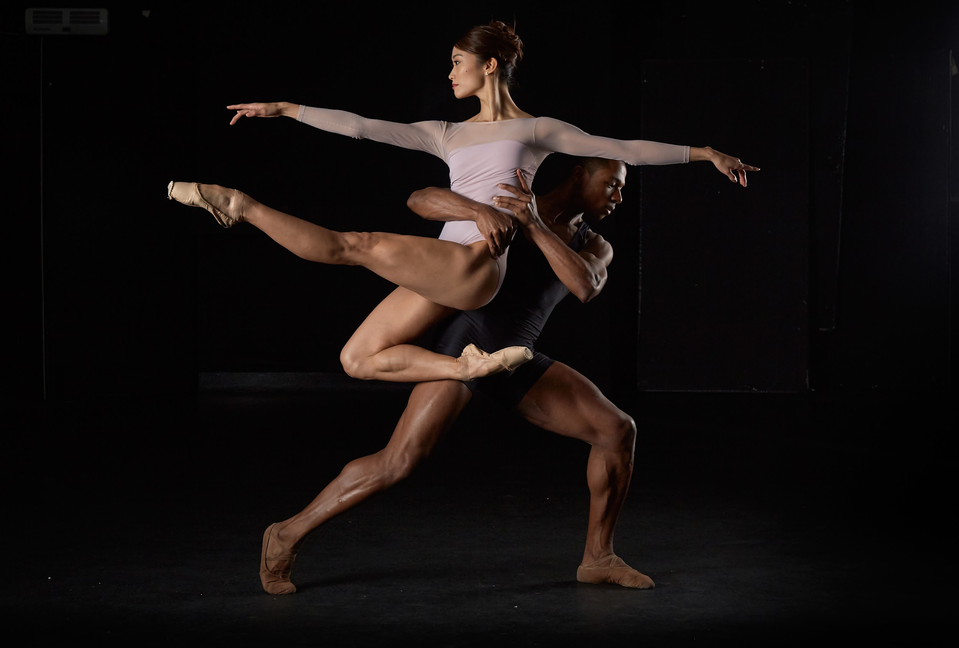
Full bleed opener
over two lines
Smaller heading size - 1 line only

Slide 26

Full bleed opener
Smaller heading size - 1 line only

Slide 27
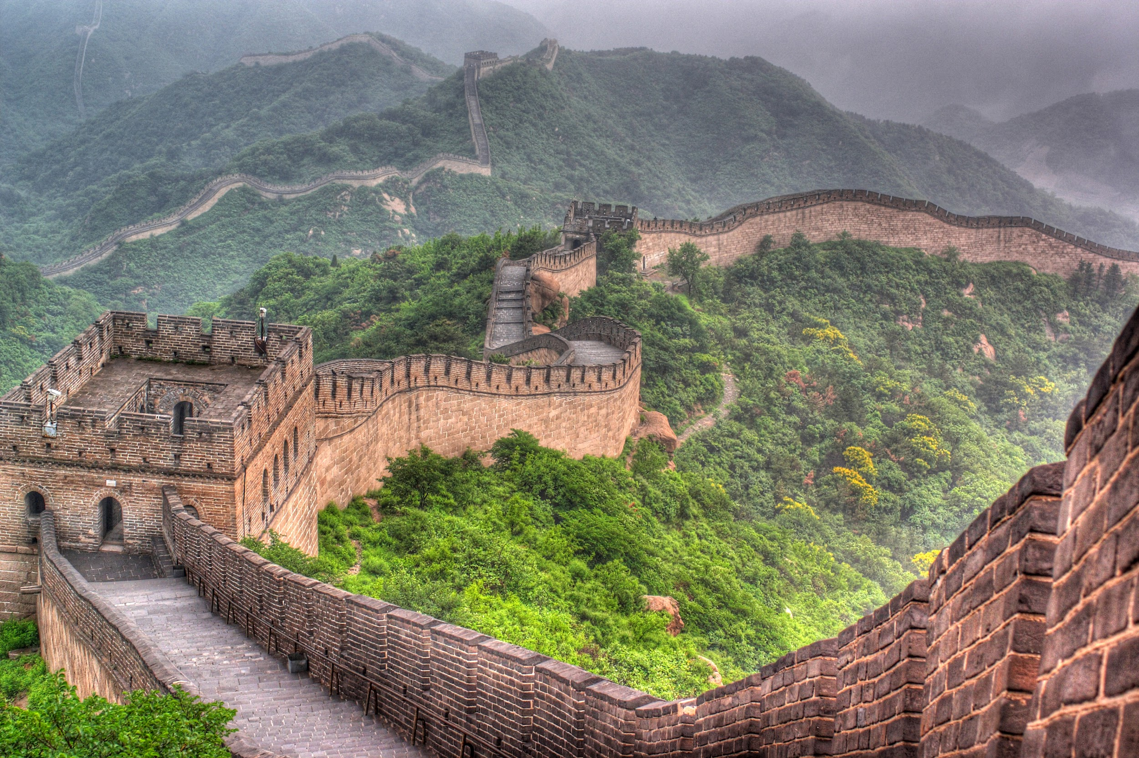
Full bleed opener
Smaller heading size - 1 line only

Slide 28

Full bleed opener
Smaller heading size - 1 line only

Slide 29
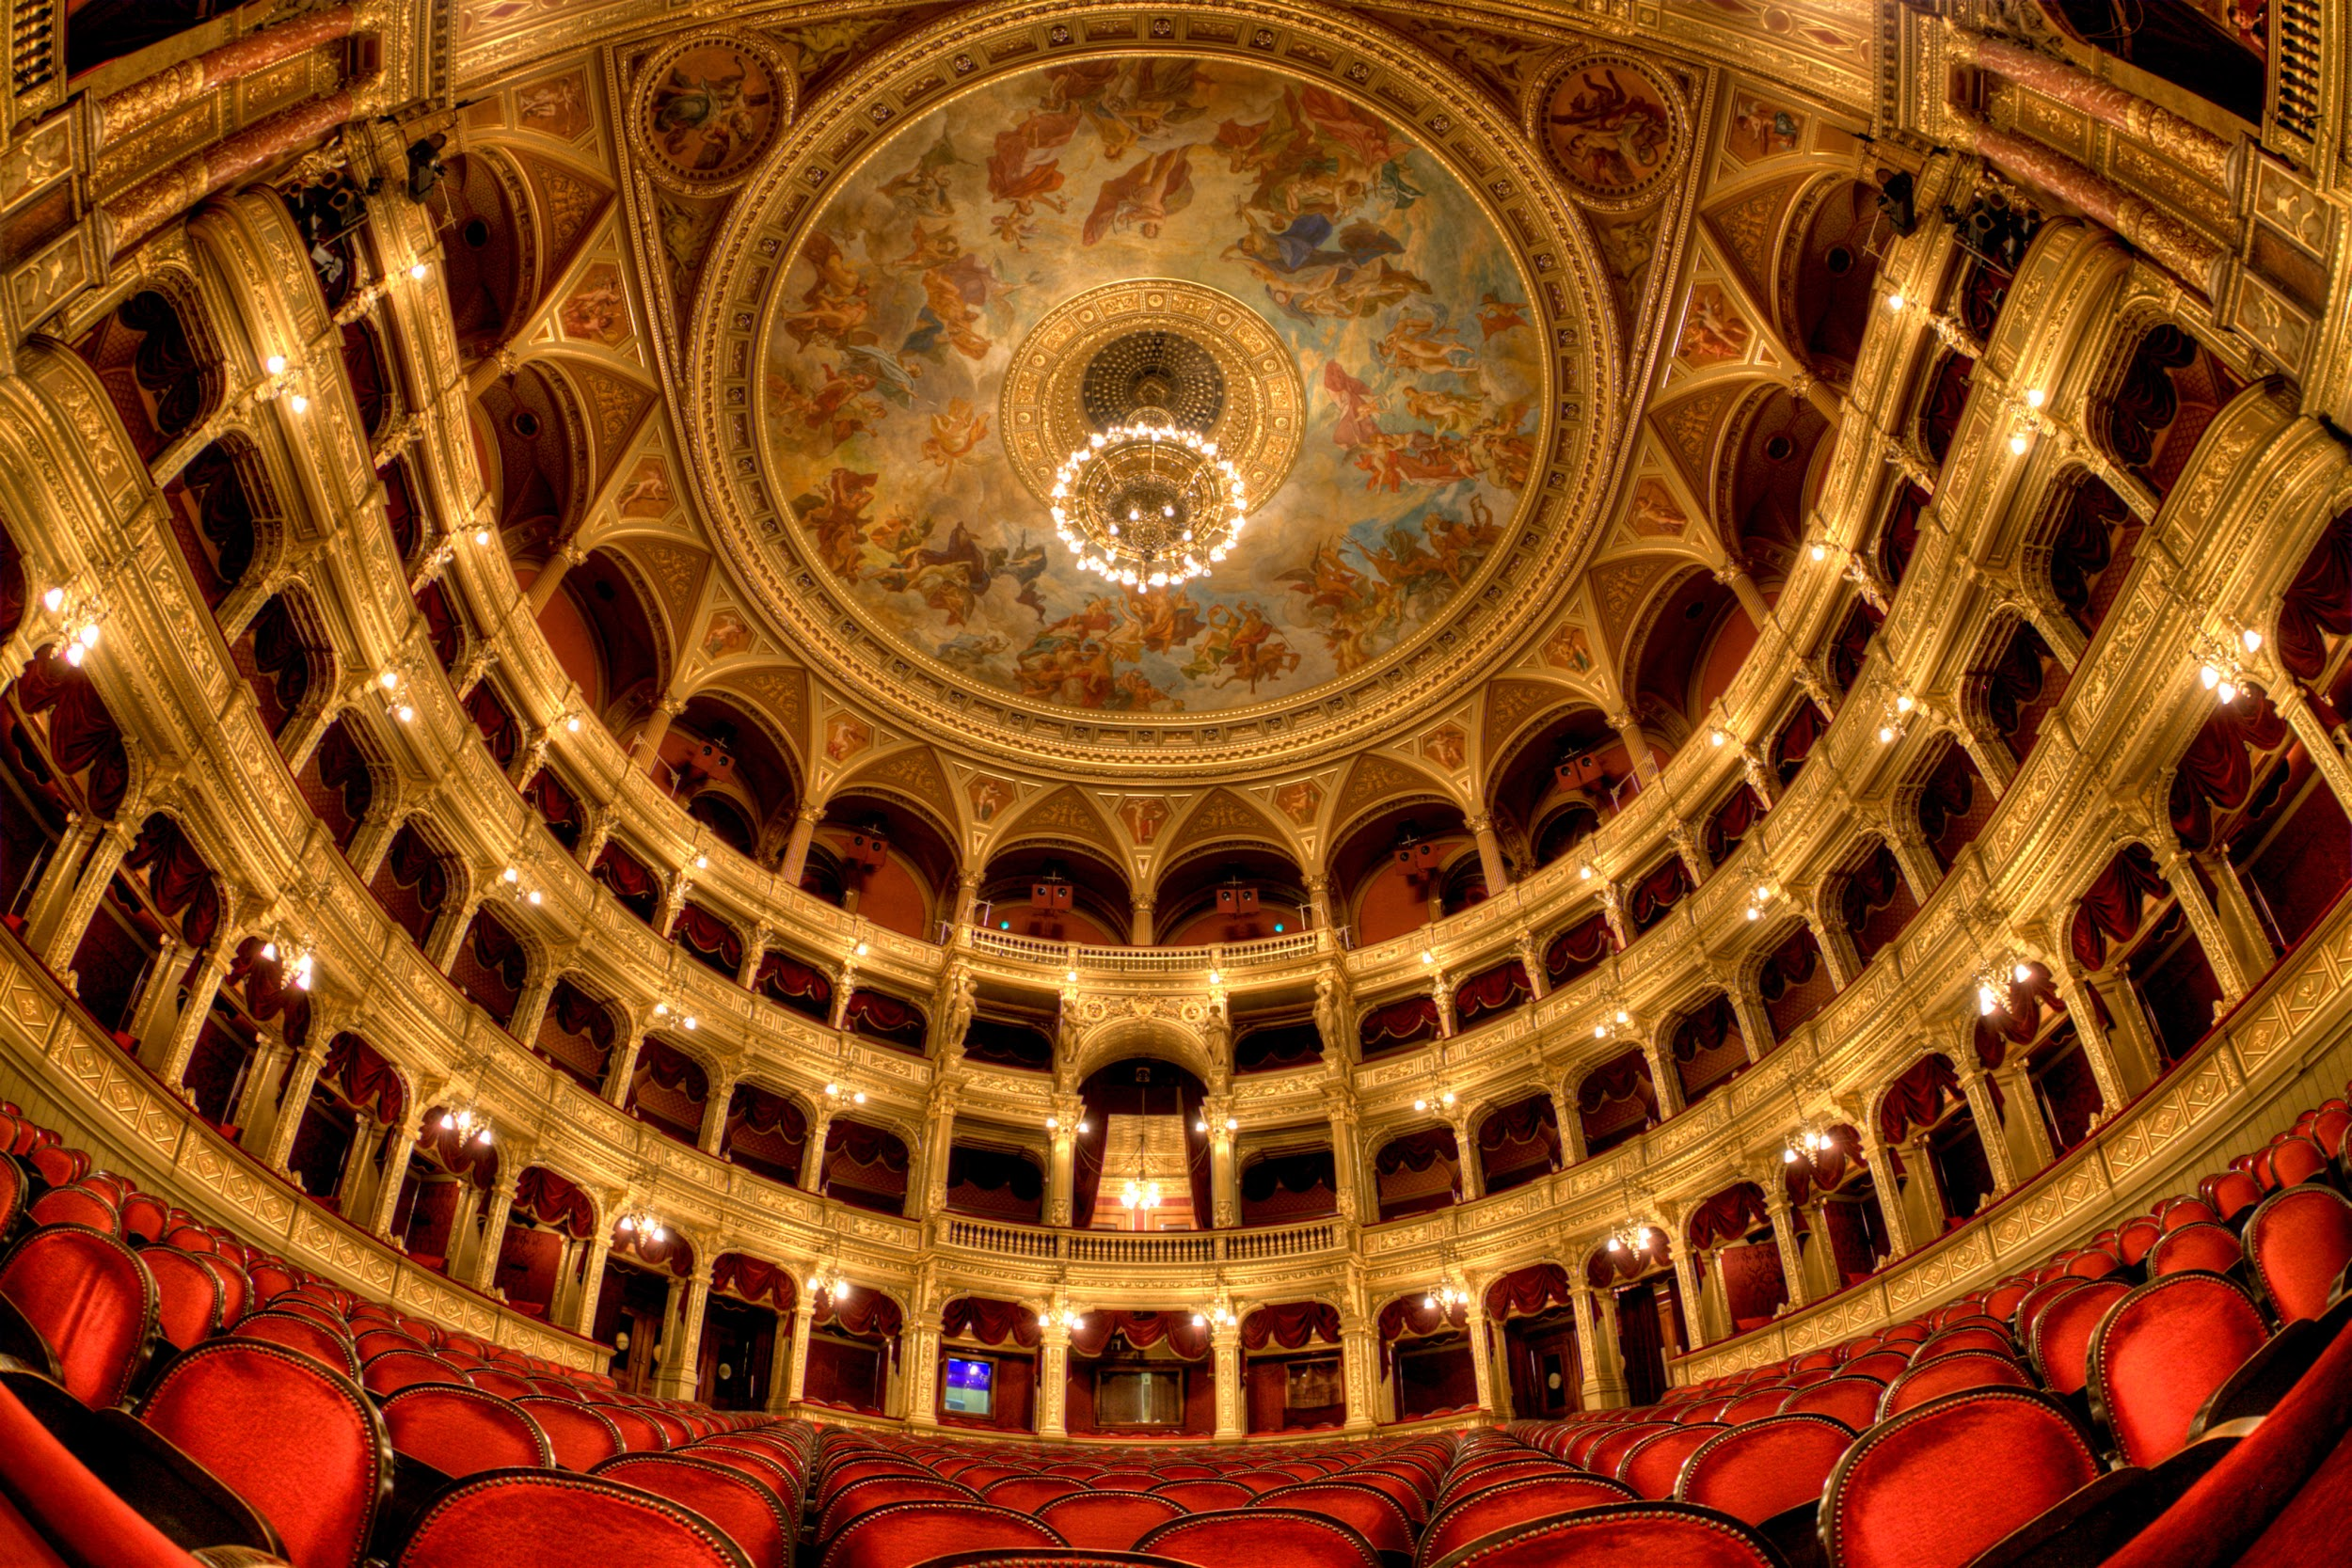
Full bleed opener
over two lines
Smaller heading size - 1 line only

Slide 30

Full bleed opener
over two lines
Smaller heading size - 1 line only

Slide 31

Full bleed opener
Smaller heading size - 1 line only

Slide 32

Full bleed opener
over two lines
Smaller heading size - 1 line only

Slide 33

Full bleed opener
Smaller heading size - 1 line only

Slide 34
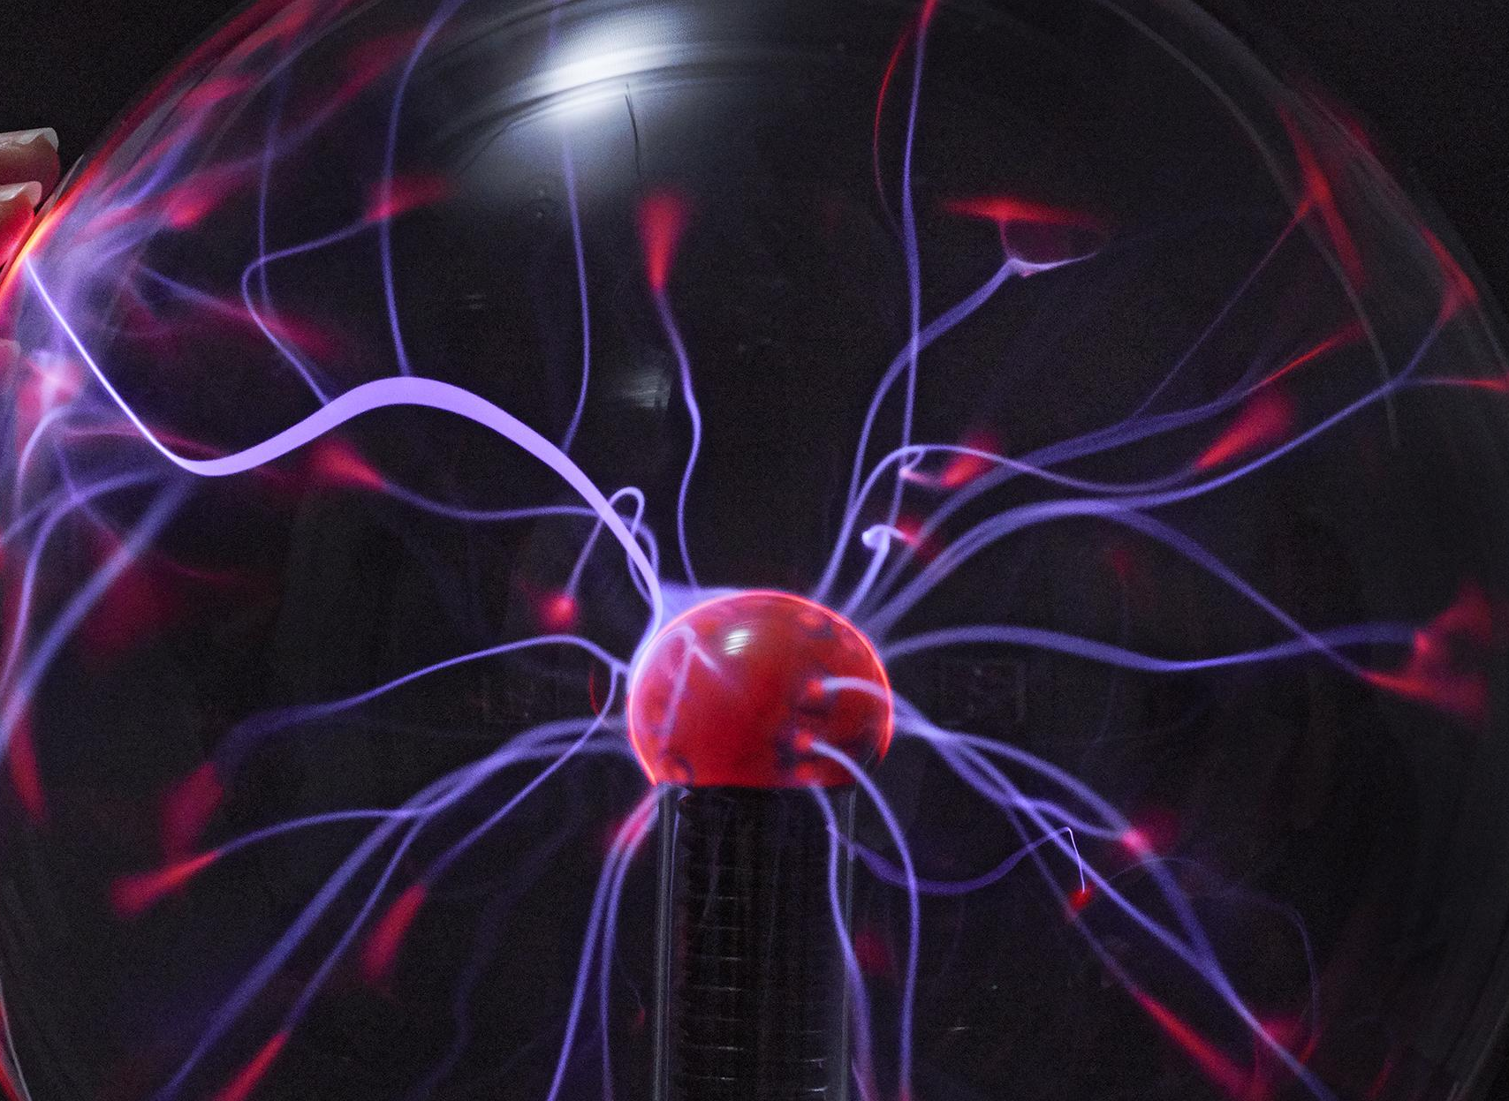
Full bleed opener
Smaller heading size - 1 line only

Slide 35
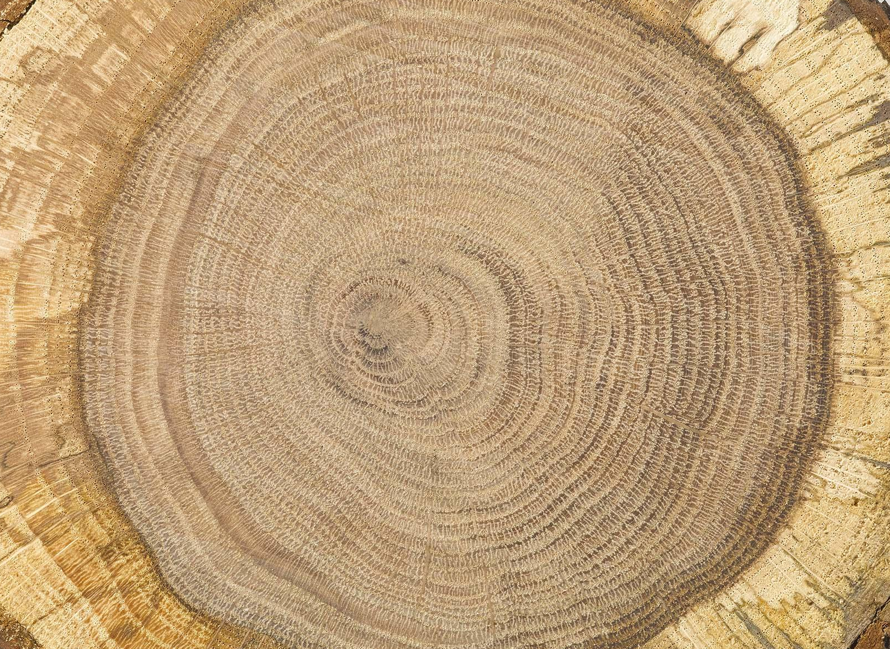
Full bleed opener
Smaller heading size - 1 line only

Slide 36

Full bleed opener
over two lines
Smaller heading size - 1 line only

Slide 37

Full bleed opener
Smaller heading size - 1 line only

Slide 38
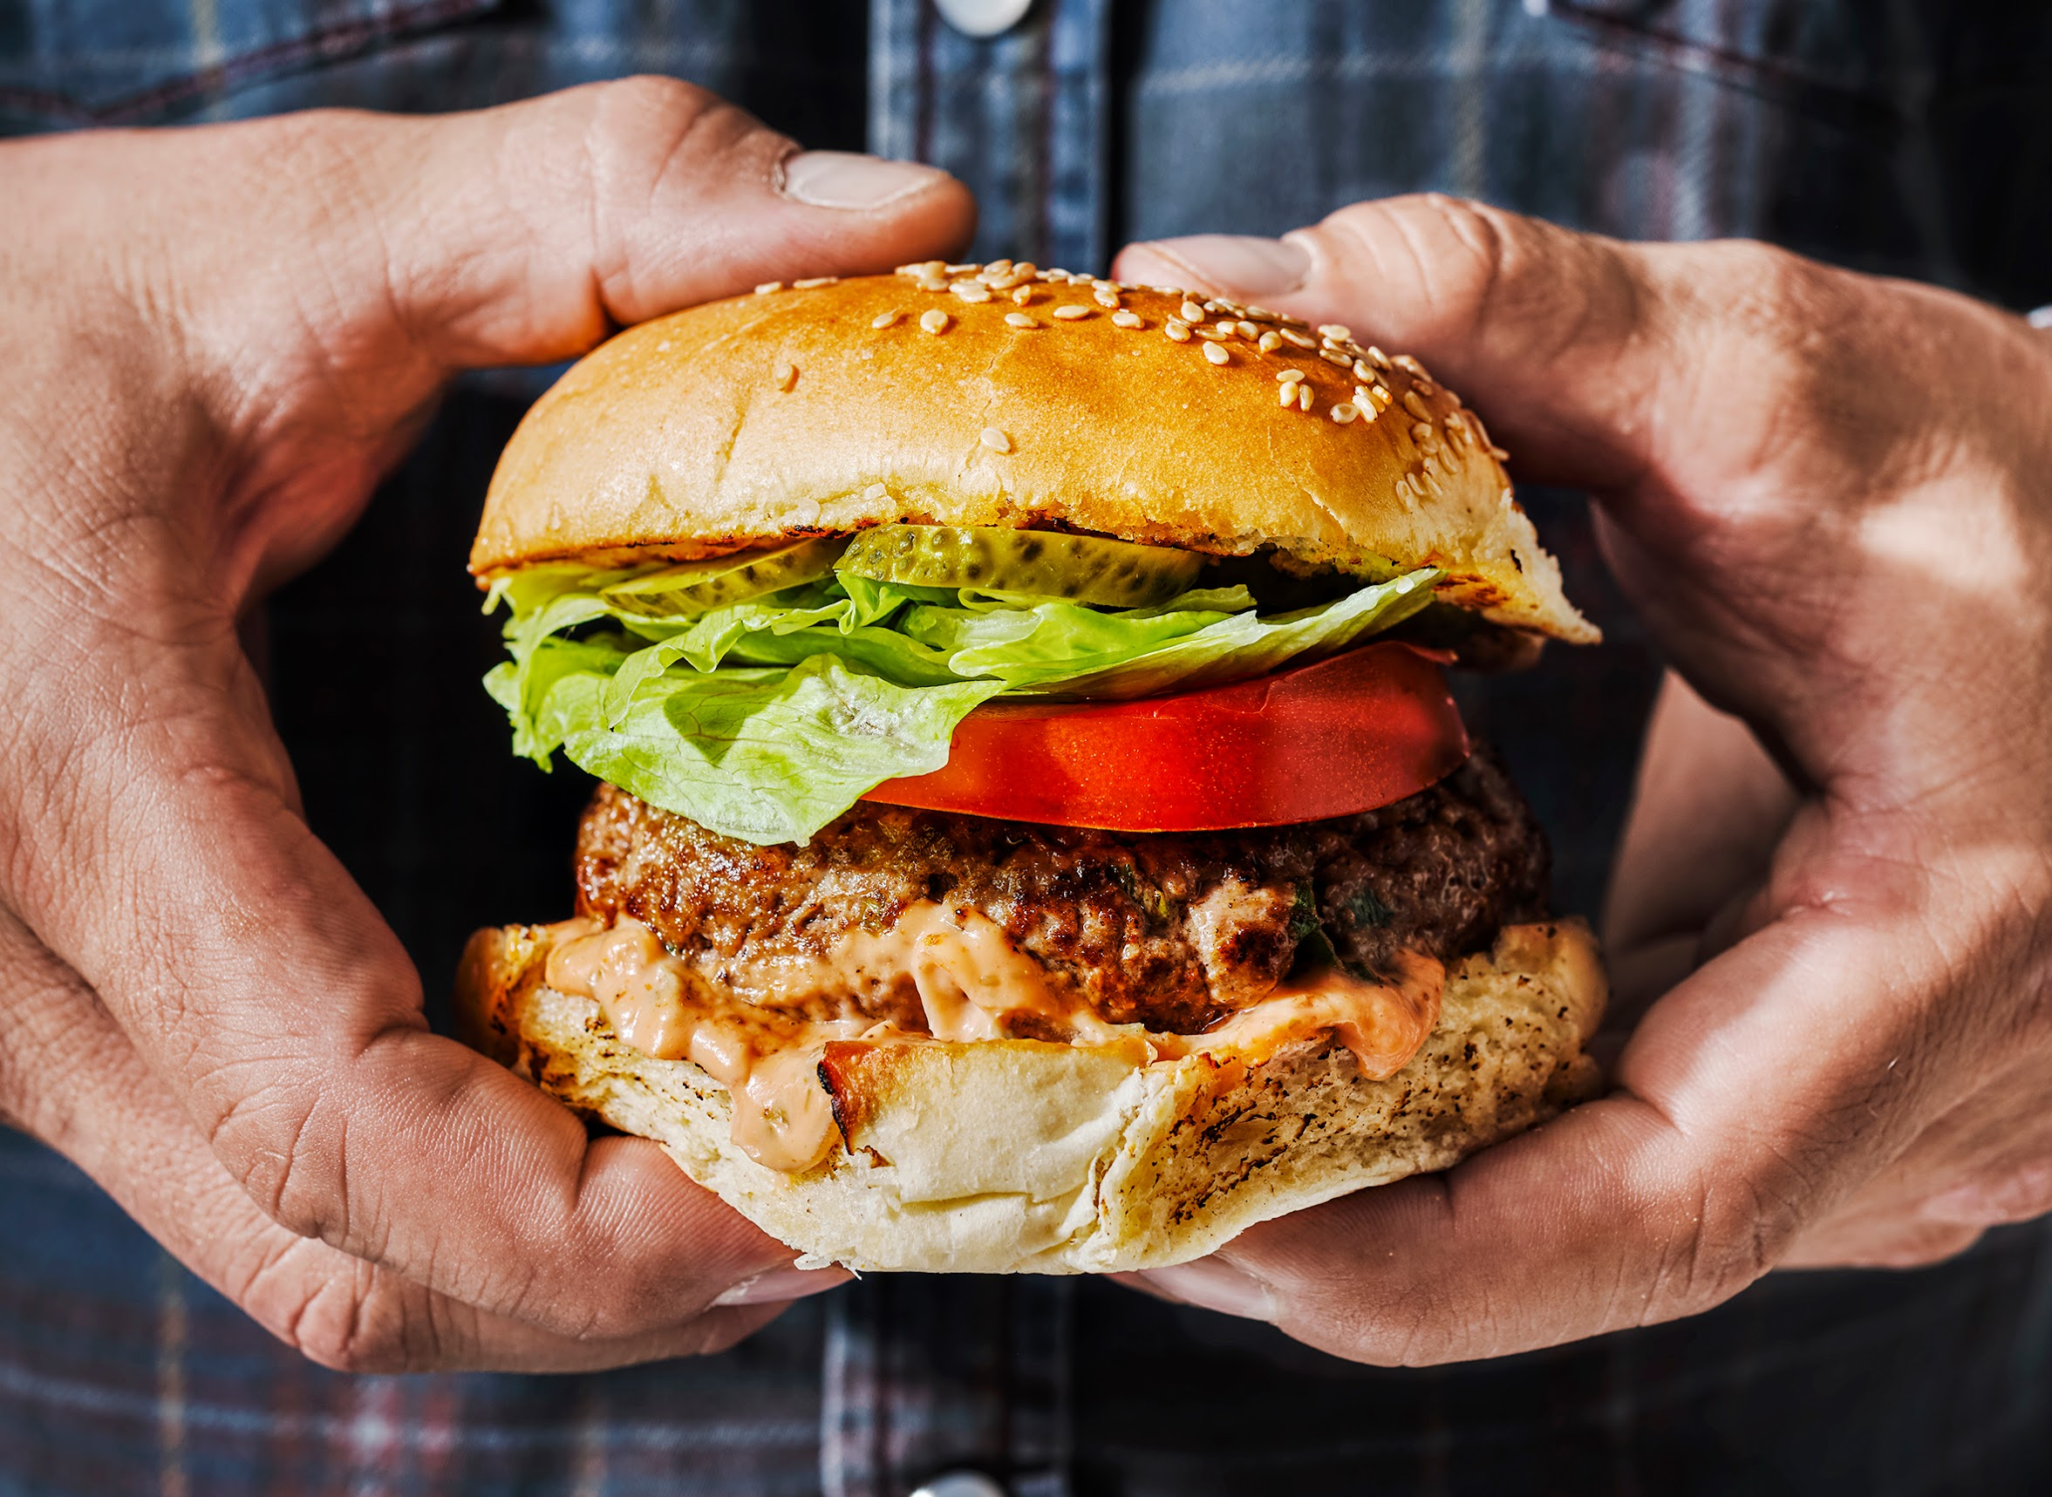
Full bleed opener
Smaller heading size - 1 line only

Slide 39

Full bleed opener
Smaller heading size - 1 line only

Slide 40

Full bleed opener
Smaller heading size - 1 line only

Slide 41

Full bleed opener
Smaller heading size - 1 line only

Slide 42

Full bleed opener
Smaller heading size - 1 line only

