Slide 1
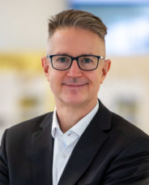
GDCh-Kolloquium
Prof. Dr. Jörg Libuda
Erlangen Catalysis Resource Center (ECRC)
"Model interfaces in catalysis, energy and
materials science: From ultrahigh vacuum to the solid/liquid interface"
https://www.ecrc.fau.eu/libuda-group/
Donnerstag, 07.12.2023, 17.00 c.t.
W32 0-005 (Experimentierhörsaal), Universität Oldenburg

